Slide 1

01
Urinary Biomarkers to Predict Pancreatic Cancer
Emma Bright
Krista Miller
DST final | May 2022

Slide 2
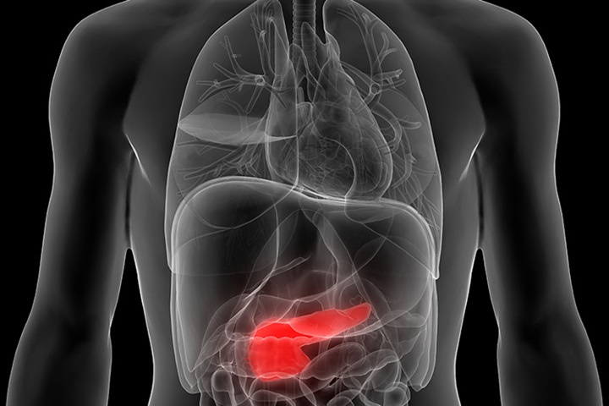
02
Purpose
PANCREATIC CANCER HAS A VERY HIGH MORTALITY RATE
5 year survival rate is 11%
Hard to detect
No isolated diagnostic test
CAN MACHINE LEARNING HELP?
How does logistic regression compare with naive bayes machine learning algorithms in predicting pancreatic cancer given patient urine samples?
DST | May 2022
Notes:
A diagnosis of pancreatic cancer is almost certainly a death sentence, with an 11% 5-year relative survival rate the chances of making it to a full recovery are extremely slim. Unfortunately, there is also no isolated diagnostic test, such as a mammogram for breast cancer or colonoscopy for colon cancer, that can help to detect this deadly disease early on. Researchers are still trying to find a way to help predict whether a patient is likely to have pancreatic cancer based on various health indicators.
The objective of this research project is to explore Logistic Regression and Naive Bayes and determine which algorithm is most effective for predicting whether a patient will be diagnosed with pancreatic cancer by utilizing various biomarkers present within a urine sample and a patient's demographic information.

Slide 3
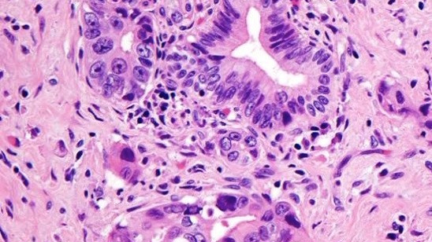
SOURCE
03
Published by the Public Library of Science (Dec 2020): "A combination of urinary biomarker panel and PancRISK score for earlier detection of pancreatic cancer: A case–control study"
METADATA
590 patients; 14 columns of data
Samples: 183 control, 209 benign pancreatic disease, 199 pancreatic cancer
Data Overview
DST |May 2022
Notes:
According to Kaggle, this data was collected by researchers for the purpose of developing an accurate way to identify patients with pancreatic cancer.
The data set that we chose consisted of 590 independent samples (obeservations), 13 feature variables consisting of demographic information and urine protein biomarkers, and a single output variable, diagnosis.

Slide 4



INPUT VARIABLES: BIOMARKERS
04
Creatinine
LYVE1
REG1B
TFF1
Variables of Interest
INPUT VARIABLES: DEMOGRAPHICS
Age
Sex
Sample location
OUTPUT VARIABLE: DIAGNOSIS
Pancreatic cancer diagnosis
DST | May 2022
Notes:
To do this, they collected biomarkers from the urine of three groups of patients (reflected as 1, 2, and 3 respectively in our 'diagnosis' output variable):
- Healthy controls
- Patients with non-cancerous pancreatic conditions, like chronic pancreatitis
- Patients with pancreatic ductal adenocarcinoma
The urinary biomarkers that were measured from these patients were: creatinine, LYVE1, REG1B, and TFF1. These protein biomarkers were selected as they are generally associated with how well a pancreas is functioning.
- Creatinine is a protein that is often used as an indicator of kidney function.
- YVLE1 is lymphatic vessel endothelial hyaluronan receptor 1, a protein that may play a role in tumor metastasis
- REG1B is a protein that may be associated with pancreas regeneration
- TFF1 is trefoil factor 1, which may be related to regeneration and repair of the urinary tract

Slide 5
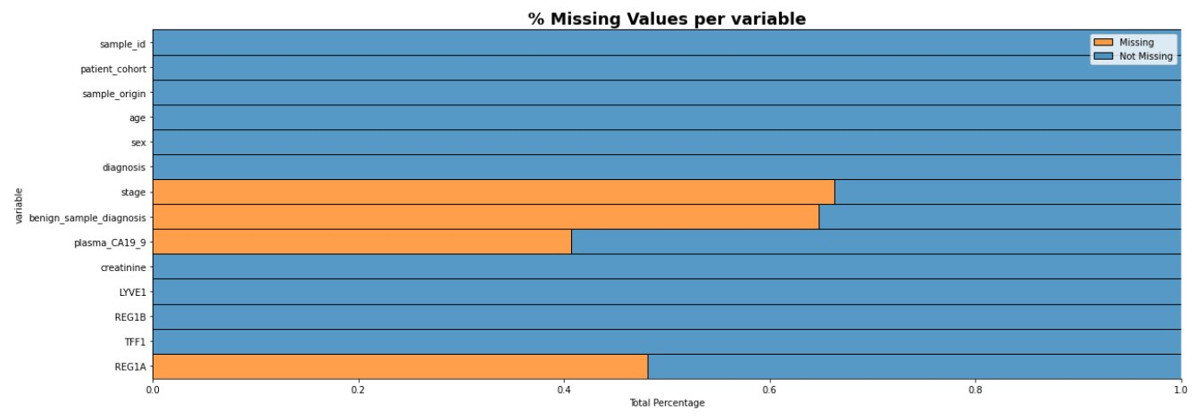
Data Preparation
05
Null handling and feature reduction
Reclassifying outcome variable
Encoding categorical variables (sex, sample origin)
Standard scaling continuous variables (age, biomarkers)
DST | May 2022
Notes:
NULLS:
We found that almost half the data was null for the 'stage', 'benign_sample_diagnosis', and 'plasma_CA19_9' features. Stage, Bengign Sample Diagnosis and Plasma CA19 are variables that are associated only with their respective diagnoses. For example, stage would have been collected for a patient who had pancreatic cancer.
DROPPED:
In addition to the NULL fields we also chose to drop columns related to the sample ID and the patient cohort.
SCALED:
Standard scaling allows us to remove any bias from our model that may be imparted by large values from the protein biomarkers, and allows each variable to be weighed more equally.
OUTPUT:
For our model, we only wanted to identify those patients that had cancer, not those who had pancreatic disease, so we chose to relabel our output variable as follows:
- 0: No pancreatic cancer OR pancreatic disease, but no cancer.
- 1: Pancreatic cancer.

Slide 6

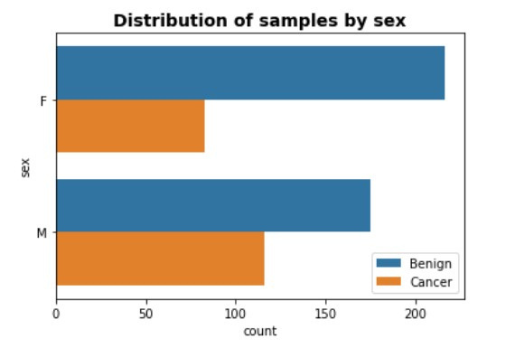
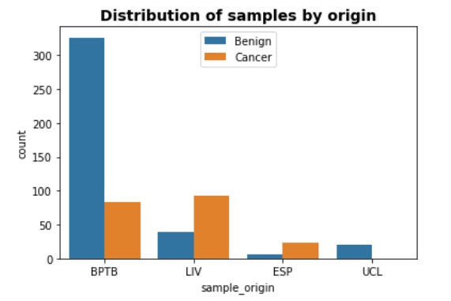
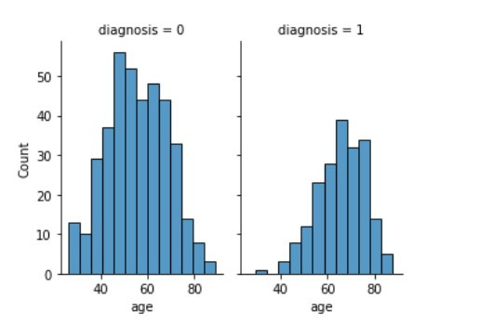
BY AGE
BY SEX
BY LOCATION
Age of patients range between 26-89 years old
Globally, the incidence of pancreatic cancer is 5.5 per 100,000 for men and 4.0 per 100,000 for women
Most samples originate from Barts Pancreas Tissue Bank, followed by the University of Liverpool
Exploratory data analysis
06

Slide 7
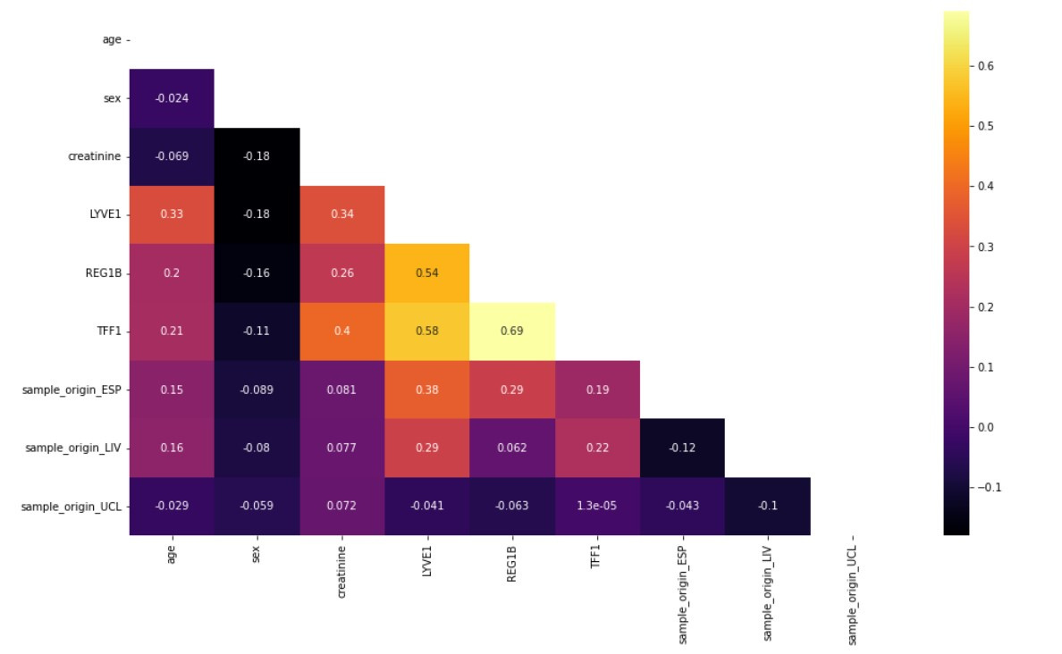
FEATURE CORRELATION
Assumption Testing
07
Notes:
Logistic Regression
- Indepdence of observations
Indepdence of feature variables (little multicollinearity)
samples within our data was collected from a different patient, and thus our observations were independent
The correlation plot below allowed us to check the collinearity of variables (independence) and gave us assurance that the assumption was satisfied.
NAÏVE BAYES:
Independence of features

Slide 8
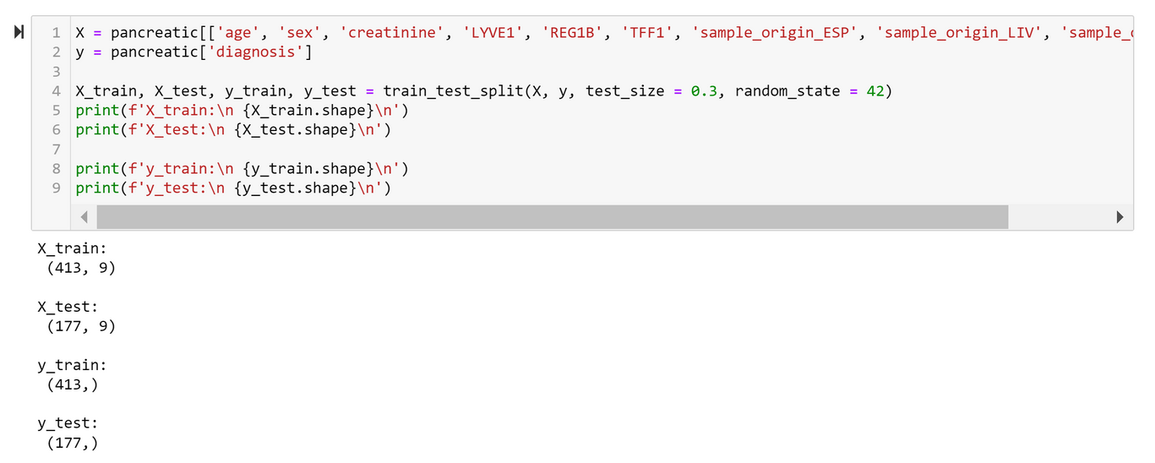
08
Train = 70%
Test = 30%
Data Splitting
DST | May 2022
Notes:
The train-test split procedure is used to evaluate the performance of a machine learning model.

Slide 9
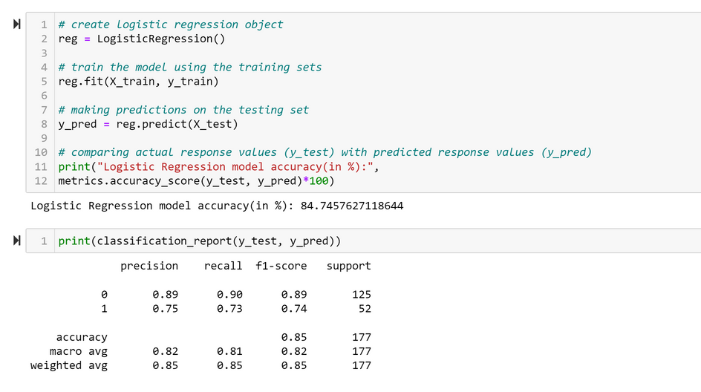
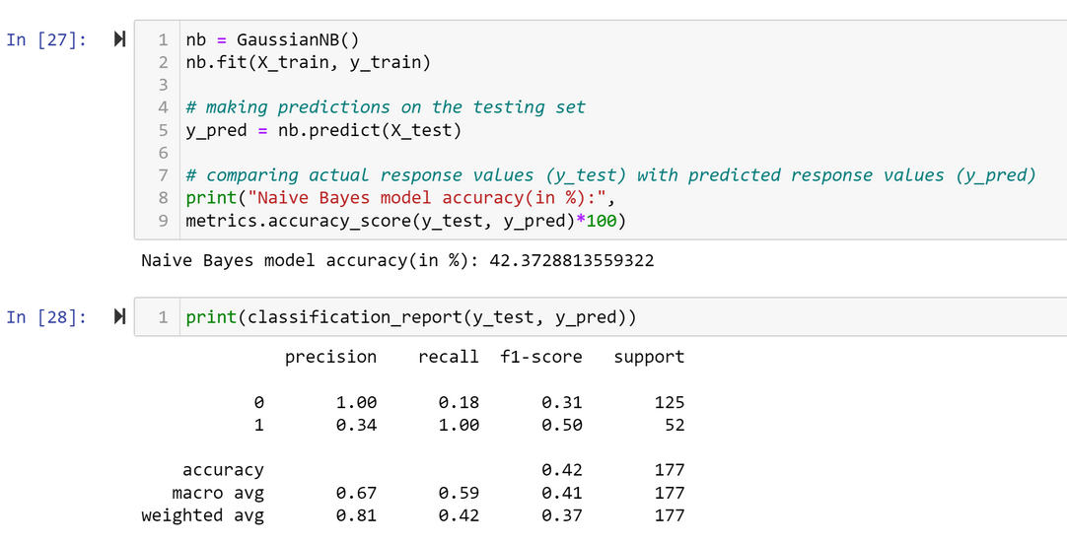
09
Logistic Regression
Naive Bayes
DST | May 2022
Notes:
Output of initial models with no tuning

Slide 10
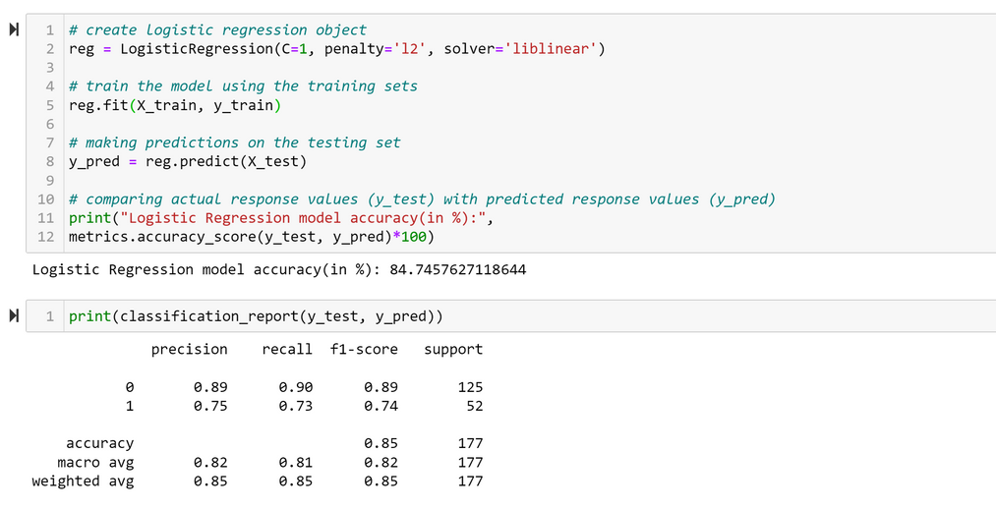
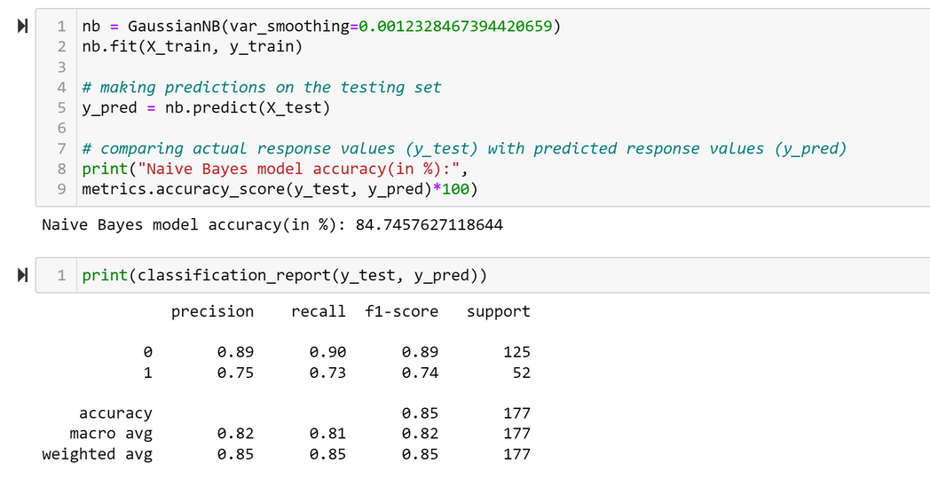
10
Model Selection &
Evaluation
dST | May 2022
Notes:
Output of models after gridsearchcv tuning

Slide 11


DST | May 2022
Conclusion
Our final model results showed that our models were equally effective at predicting whether a patient was likely to be diagnosed with pancreatic cancer. The overall accuracy rate of our models was 84%.
11

